Slide 1

Sending punched cards to the cloud
Tomasz Bartoszewski
https://github.com/tomaszbartoszewski

Slide 2
Plan:
0. What we do
Working with Azure
SAP Integration overview
System architecture
What didn’t work we learned
Demo

Slide 3
Invest
Revenue management tool for promotions
FMCG - Fast-moving consumer goods
Generating reports
Calculations, calculations and a bit more calculations

Slide 4
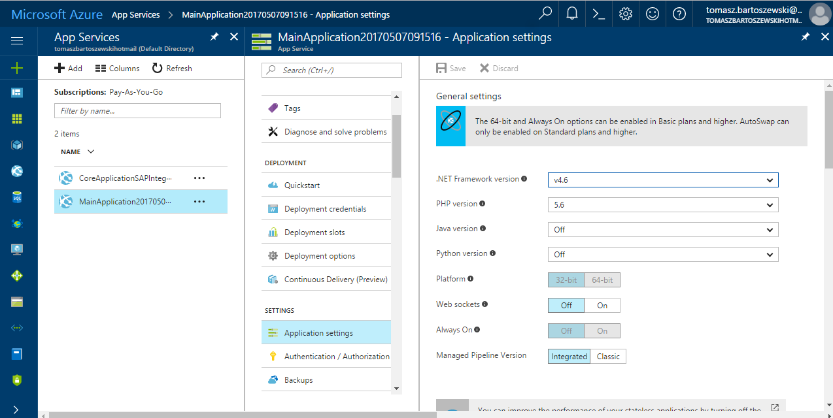
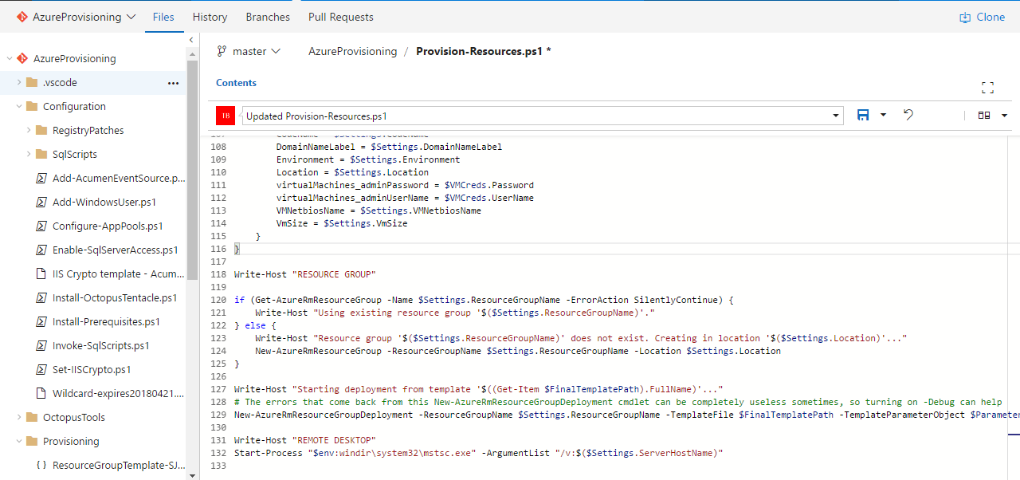
Colourful portal vs blue PowerShell
https://github.com/Azure/azure-sdk-for-net/tree/Fluent

Slide 5


Integration is simple

Slide 6
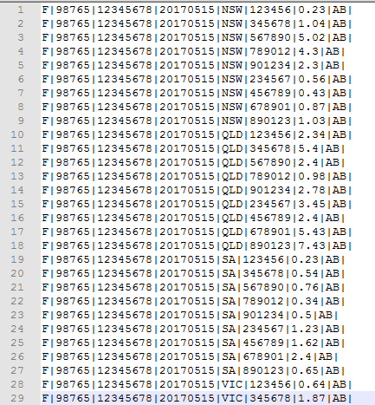

Slide 7



Punched cards are strong with SAP

Slide 8
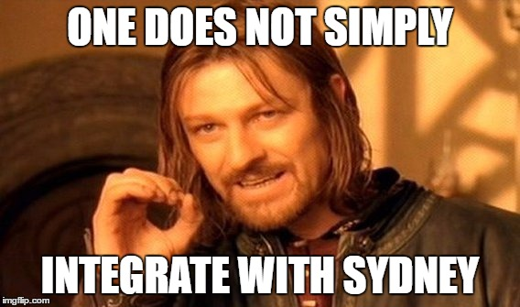
How to make it more painful?

Slide 9
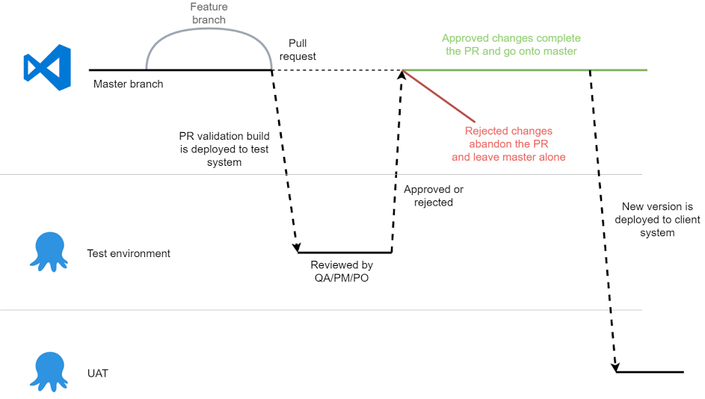
Continuous Delivery

Slide 10
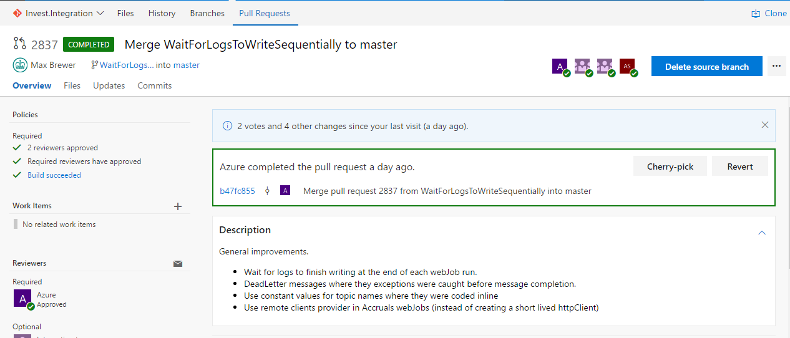
Continuous Delivery

Slide 11
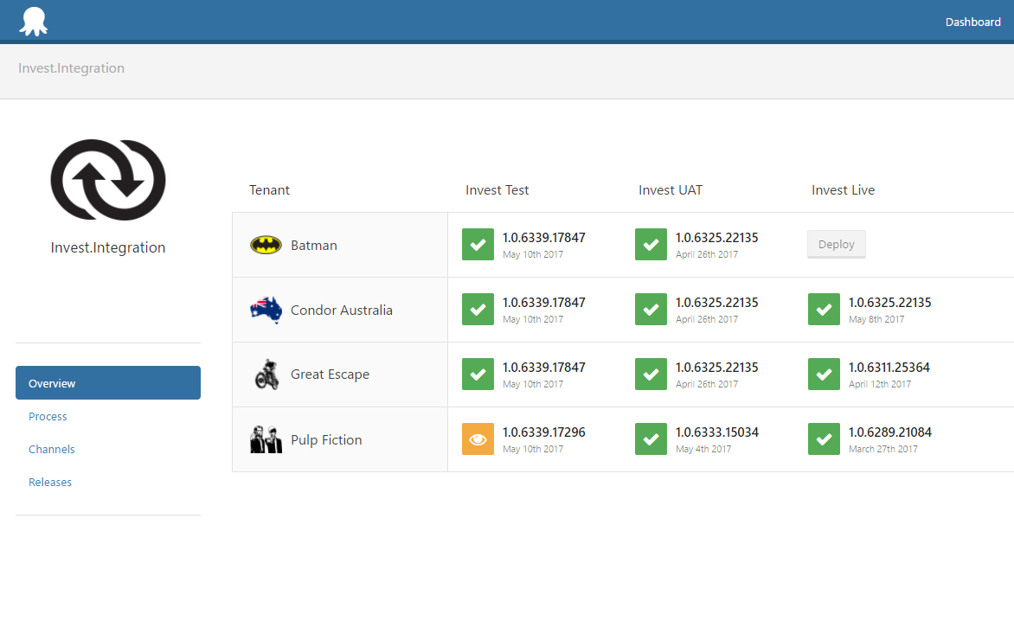

Slide 12
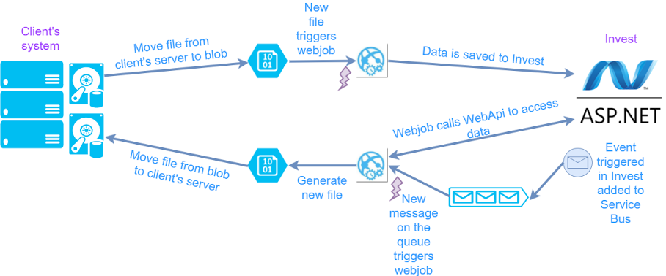
Integration architecture

Slide 13


Slide 14

One webjob per interface is not cool

Slide 15

Sending emails with errors

Slide 16


Shiny new technology

Slide 17
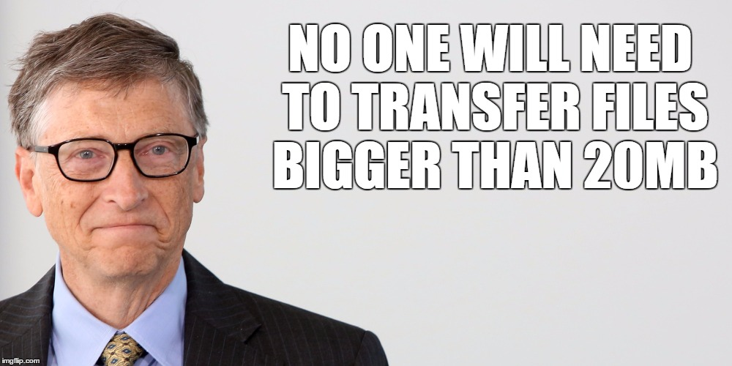
Early version of File Connector

Slide 18

DEMO

